Slide 1
Welcome to
Our Sunday School
We’ll start at 9:07
visit OurSundaySchool.com for more about our class

Slide 2
Today’s class (pages 19-24)
Philippians 3:1-2a

Slide 3
Philippians 3:1-2a (CSB)
In addition, my brothers and sisters, rejoice in the Lord. To write to you again about this is no trouble for me and is a safeguard for you.
Watch out

Slide 4
Today’s class (pages 19-24)
Philippians 3:1-2a

Slide 5
λοιπόν (G3063): loipon (loy-PAHN)
Strong’s: something remaining

Slide 6
What do other English translations do?
“Whatever happens” – NLT
“Finally” – ESV, KJV, NKJV, NASB1995, Amplified, HCSB, CEV, etc.
“In addition” – CSB
“Further” – NIV

Slide 7
BDAG on loipon (loy-PAHN) (1) as far as the rest is concerned, (2) beyond that, (3) in addition, (4) finally specifically referencing Philippians 3:1: “as a transition to something new”

Slide 8
“Semantic range” example: trunk

Slide 9
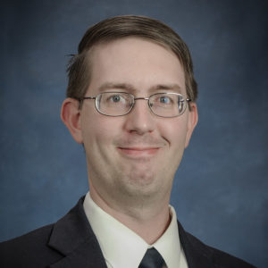
Paul Himes (via Logos.com) If “context is king,” then “semantic range is parliament,” for semantic range represents the will of the people.

Slide 10
What is the structure of Philippians?

Slide 11
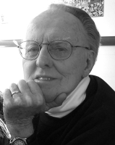
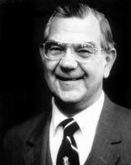
Dr. G. F. Hawthorne & Dr. Ralph P. Martin 1:12-2:30: News and Instructions 3:1-21: Digression… 4:1-9: Exhortations… 4:10-20: Gratitude…

Slide 12
Dr. Gordon Fee 1:12-26: Paul’s “Affairs” 1:17-2:18: The Philippians’ “Affairs” 2:19-30: What’s Next 3:1-4:3: Their “Affairs” Again

Slide 13
Dr. G. Walter Hansen (1/2) 1:3-11: Prayers for Partners 1:12-26: Reports of Gospel Ministry 1:27-2:18: Imperatives for Citizens Worthy of the Gospel

Slide 14
Dr. G. Walter Hansen (2/2) 2:19-30: Recommendations of Christ-like Servants 3:1-21: Disclosures of Personal Experience 4:1-9: Final Appeals 4:10-20: Thanks for Gifts from Partners

Slide 15
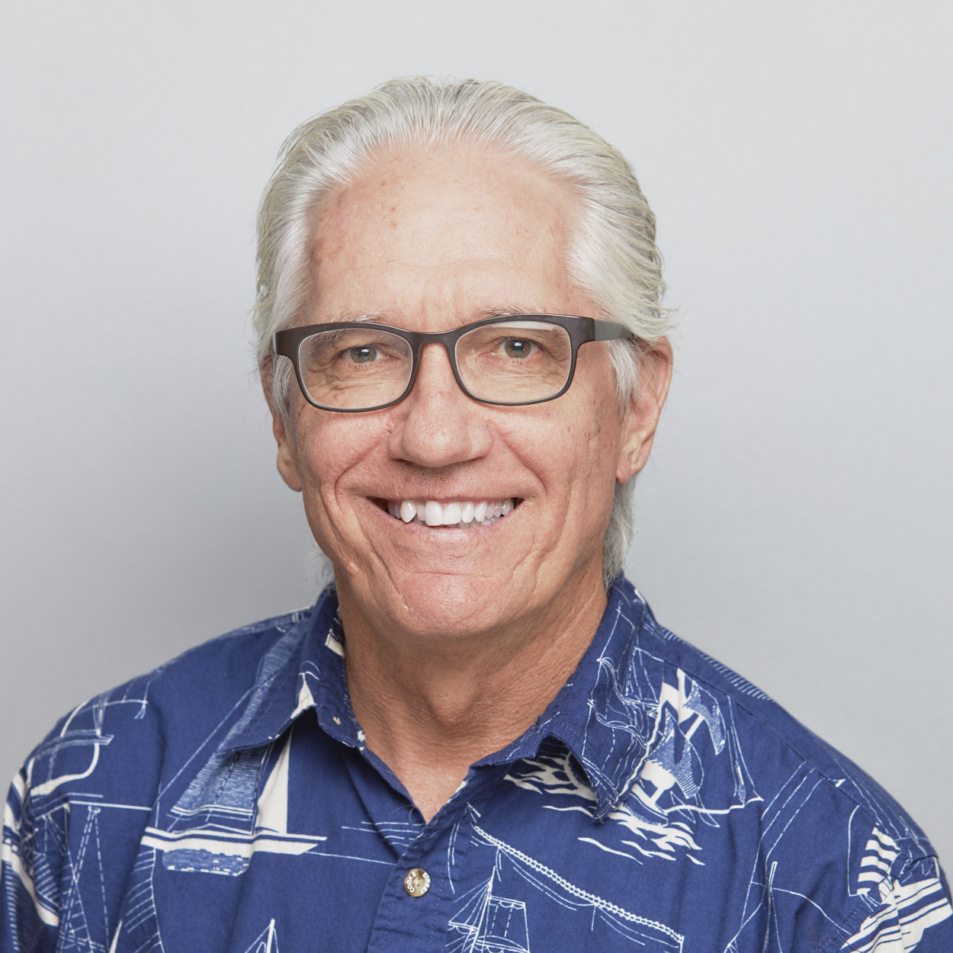
Dr. Joe Hellerman (1/2) 1:12-26: Paul’s Circumstances and the Gospel 1:27-4:9: Body of the Letter 4:10-20: Paul’s Circumstances and the Philippians’ Gifts

Slide 16
Dr. Joe Hellerman (2/2) 1:27-30: Summary Exhortation to Unity and Steadfastness 2:1-30: Unity Among Believers 3:1-4:1: Steadfastness Toward Opponents 4:2-9: Final Words of Exhortation

Slide 17
Dr. Matthew Harmon (1/2) 1:1-26: The Progress of the Gospel 1:27-4:3: Living as Kingdom Citizens in a Manner Worthy of the Gospel 4:4-23: Growth and Gratitude in the Gospel

Slide 18
Dr. Matthew Harmon (2/2) 2:19-4:3: Examples of a Christ-like Mindset 2:19-30: Paul’s Co-workers 3:1-14: Paul himself 3:15-4:3: The Call to Imitate Paul and His Co- workers

Slide 19
So what should we do with this word?
here
“Whatever happens” – NLT
“Finally” – ESV, KJV, NKJV, NASB1995, Amplified, HCSB, CEV, etc.
“In addition” – CSB
“Further” – NIV

Slide 20
Today’s class (pages 19-24)
Philippians 3:1-2a

Slide 21
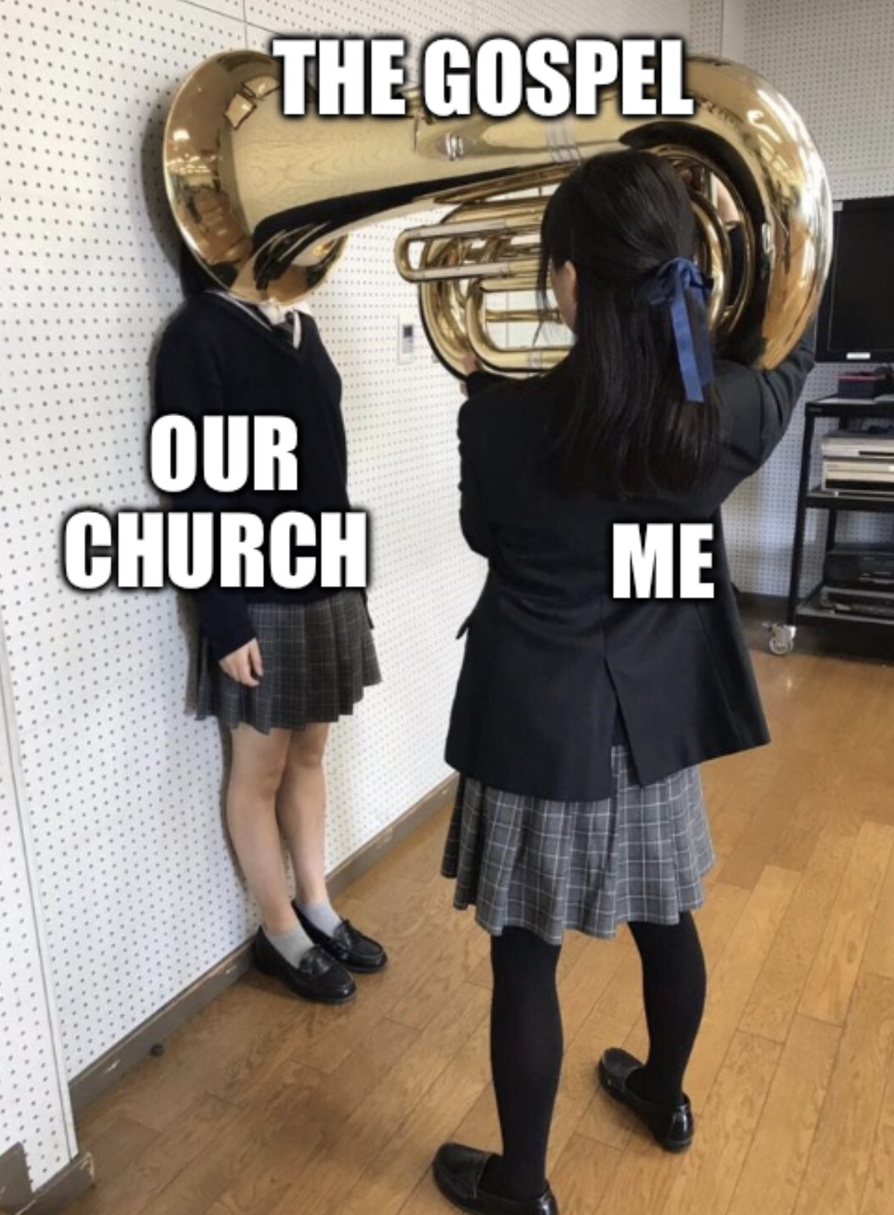
From @DannySlavich on Twitter

Slide 22
Today’s class (pages 19-24)
Philippians 3:1-2a

Slide 23
Prayer Time
Write down your prayer requests (on the Weekly Update or in the comments)
Lean in, engage, and pray for someone not with you
Go worship

Slide 24
Today’s class (page 16)
Preparing for Philippians 1:1-30
Pray with others
Hear with others
Think with others
Study with others In class, as a table
Share with others
Invite others After class
In class, as a class

Slide 25
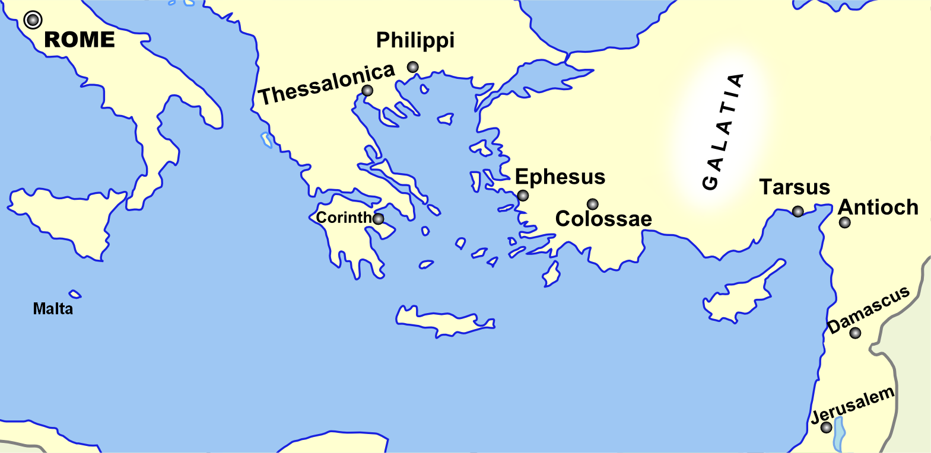
Monozigote. (2012). Broad Overview of Geography Relevant to Paul of Tarsus [Map]. Wikipedia.

Slide 26
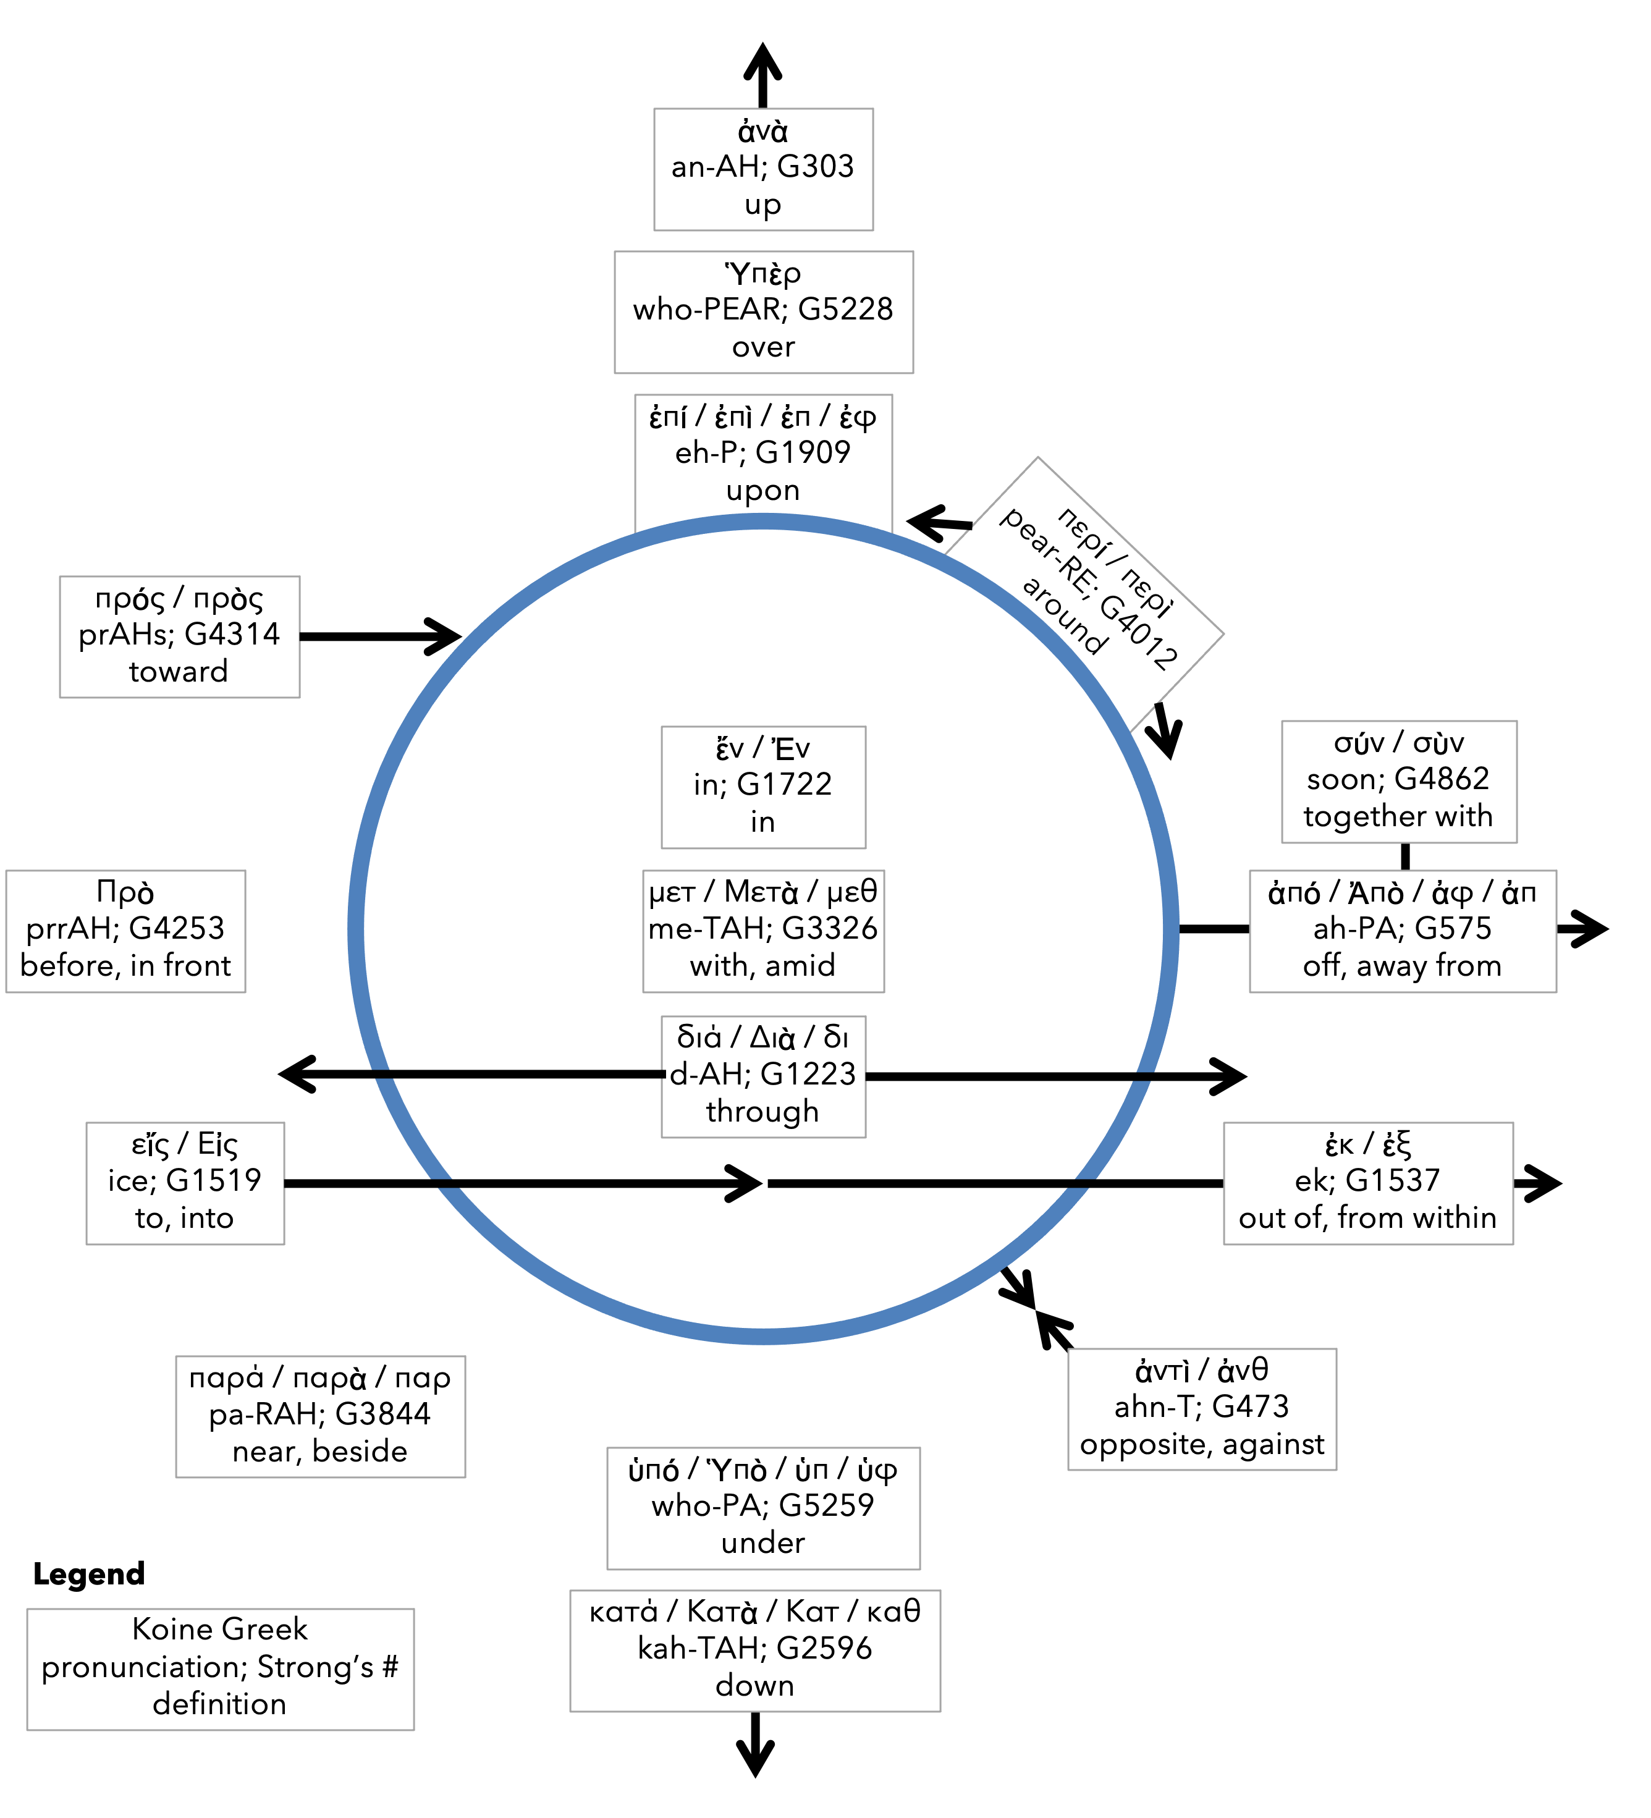
Preposition circle (page 11)

Slide 27
BDAG on morphe (mor-FAY) form, outward appearance, shape

Slide 28
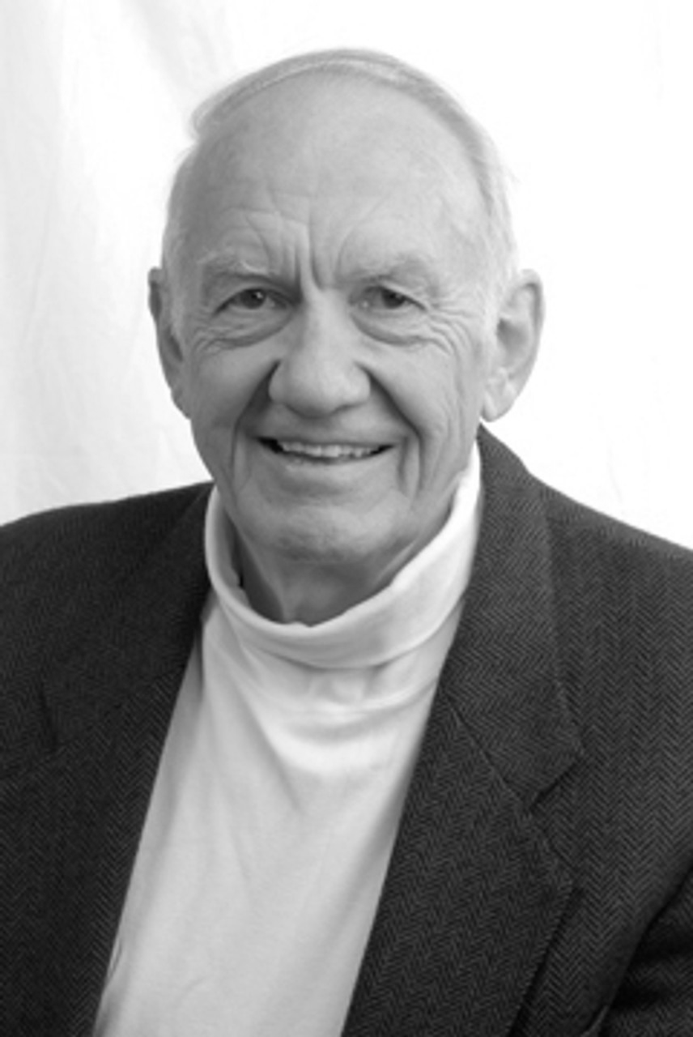
Dr. Gordon Fee Quote

Slide 29
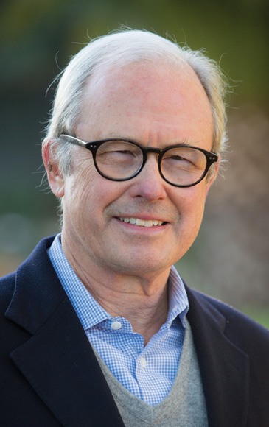
Dr. G. Walter Hansen Quote

Slide 30
Dr. G. F. Hawthorne & Dr. Ralph P. Martin Quote

Slide 31
Dr. Joe Hellerman Quote

Slide 32
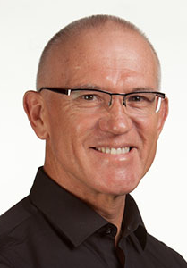
Dr. Mark Keown Quote

Slide 33
Dr. Ralph P. Martin Quote

Slide 34
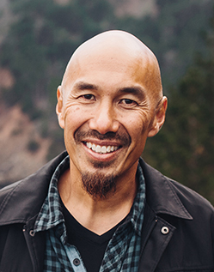
Dr. Tony Merida & Frances Chan Quote

Slide 35
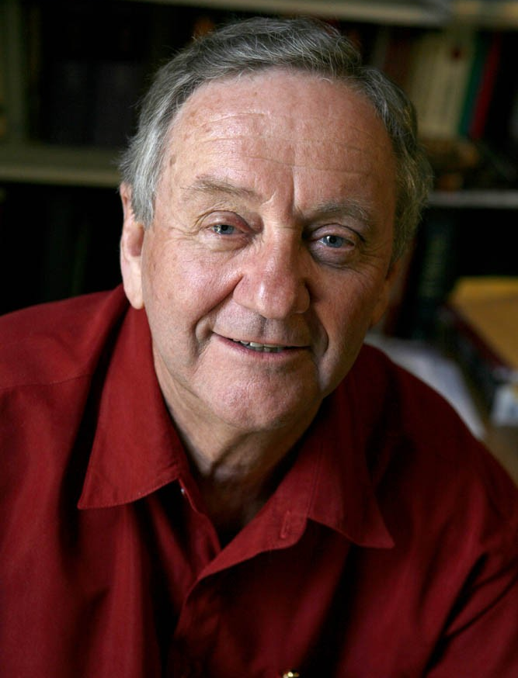
Dr. Peter T. O’Brien Quote

Slide 36
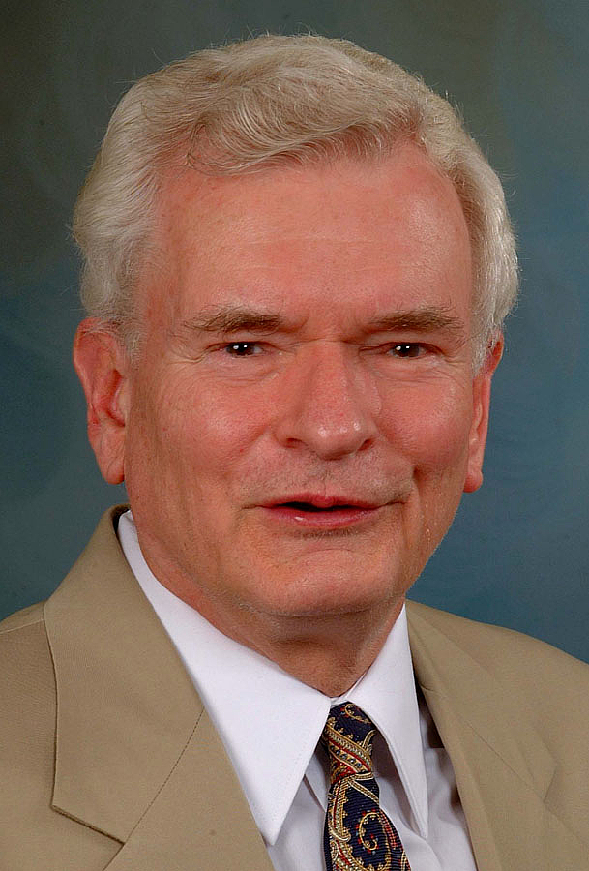
Dr. John Reumann Quote

Slide 37
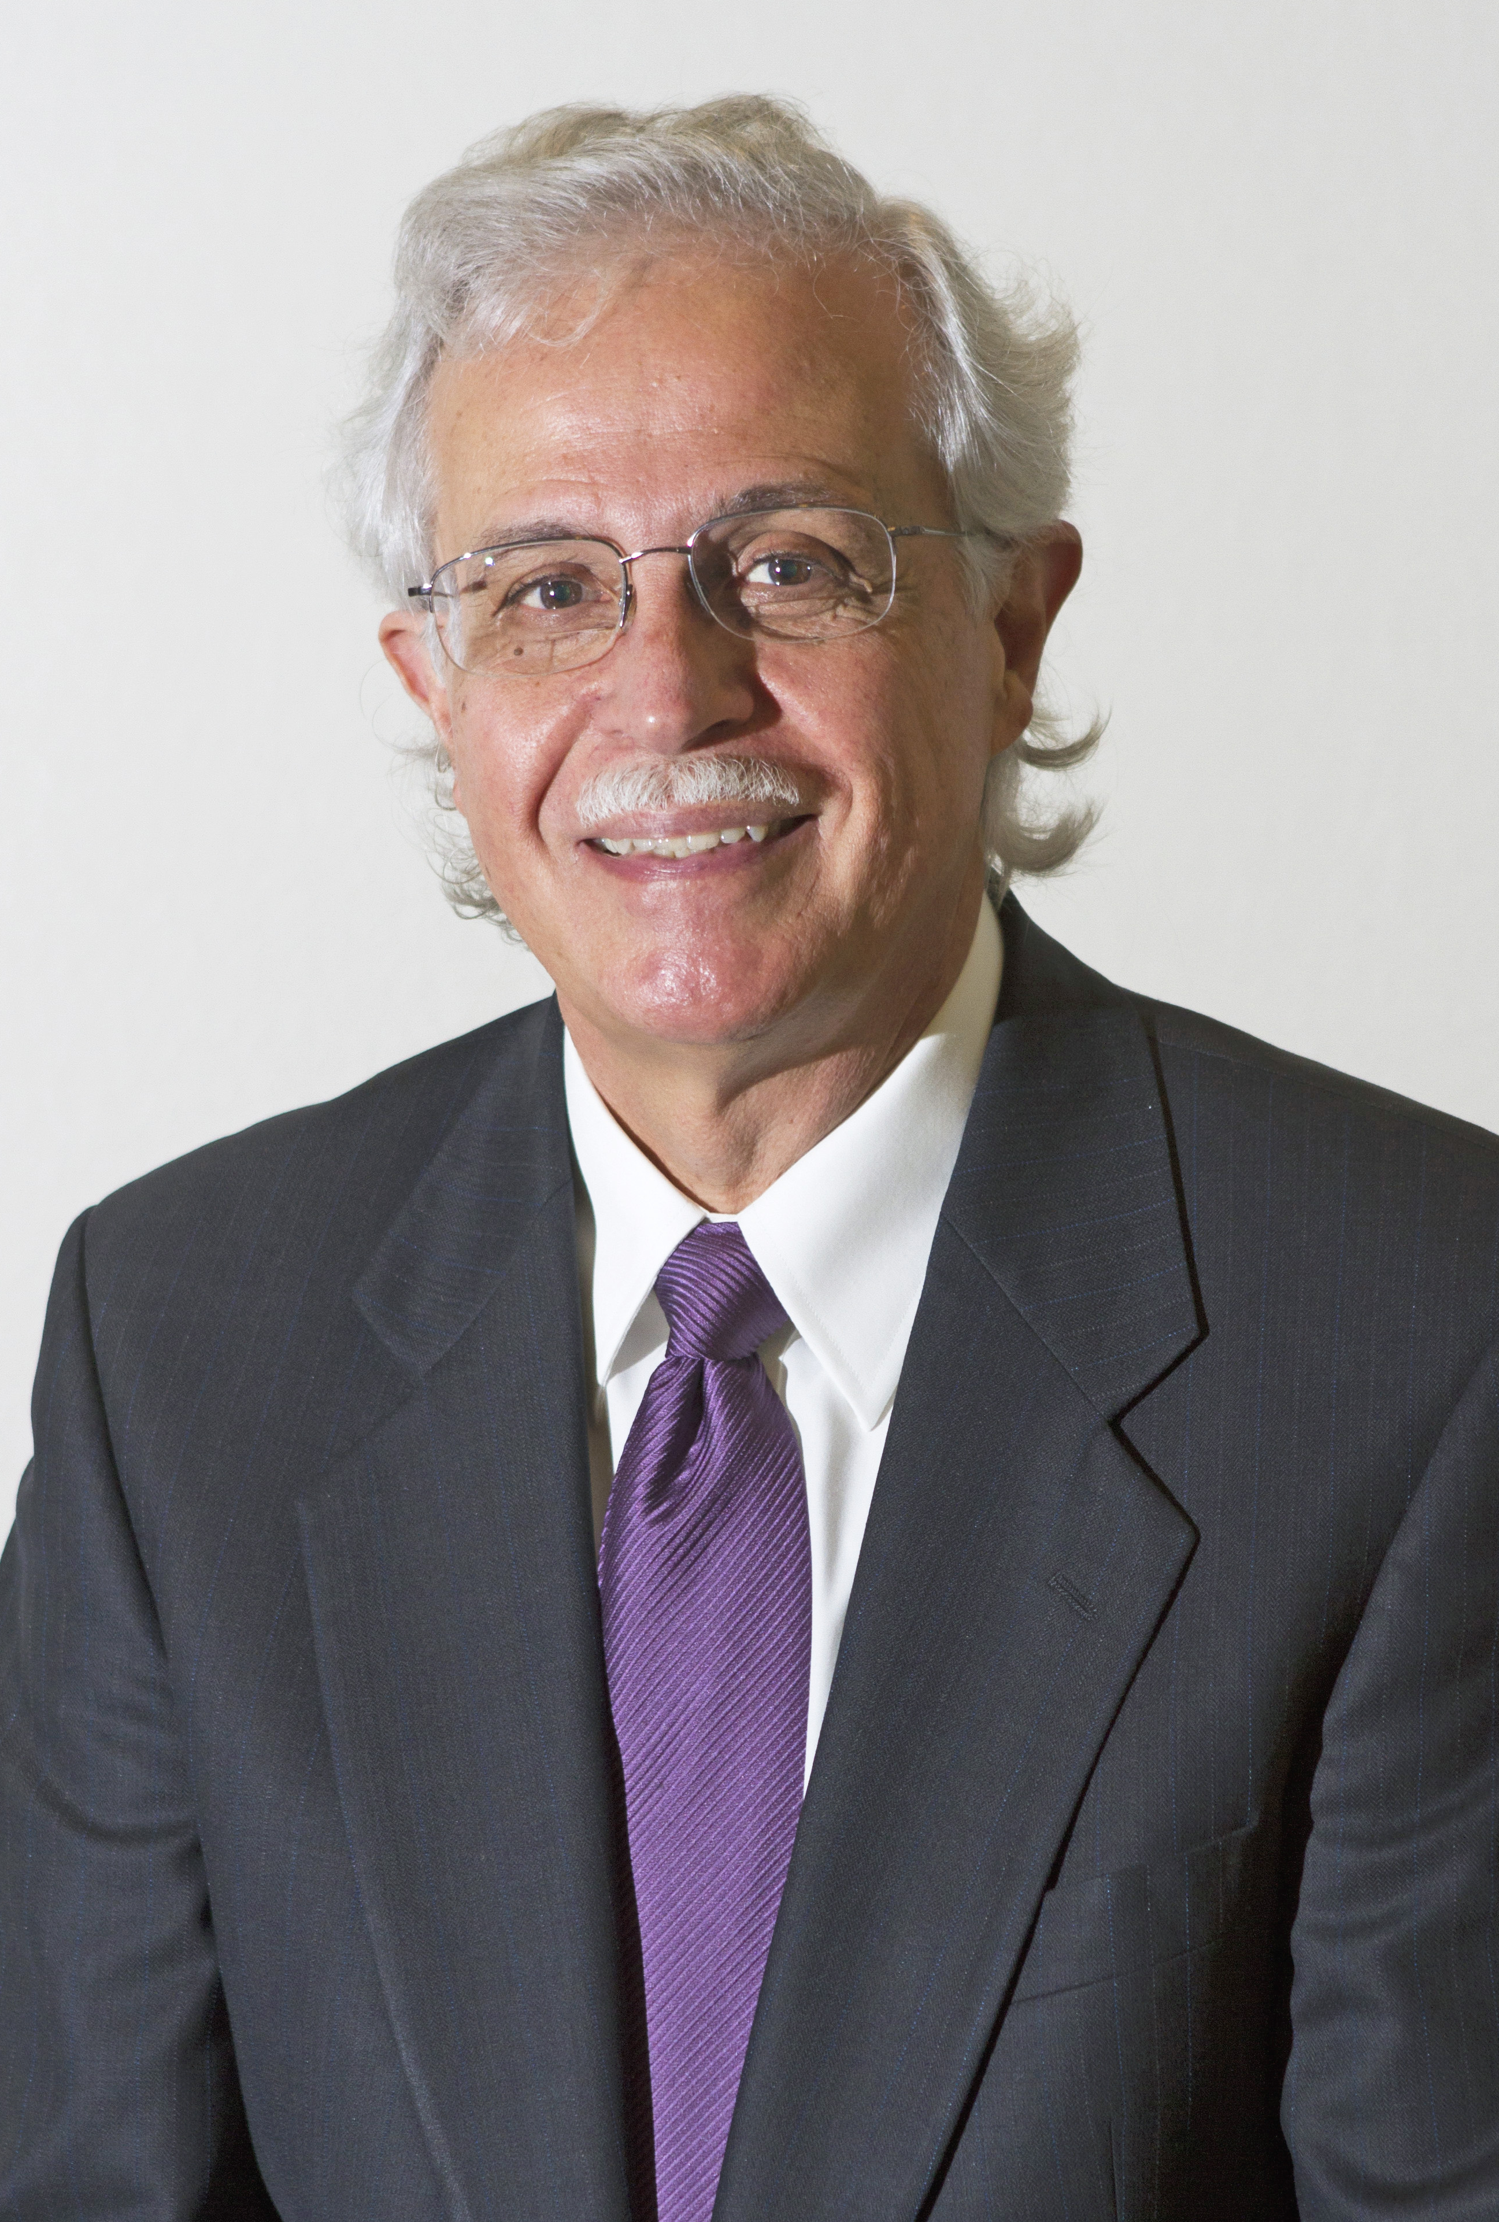
Dr. Moises Silva Quote

Slide 38
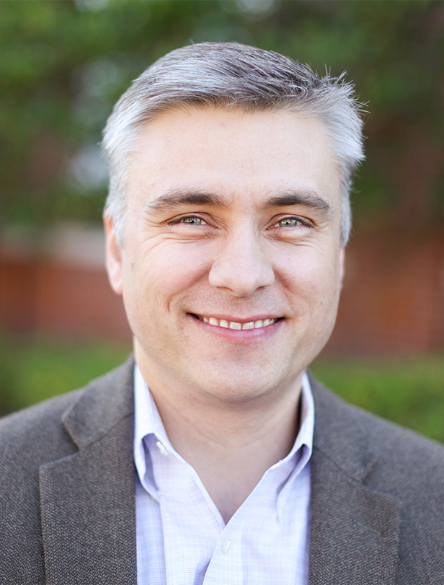
Dr. David T. A. Strain Quote

Slide 39
Jen Wilkin Quote

